Slide 1
Walmart Midterm Project Report
Emma, Anastacia, Liv, and Caroline

Slide 2
Overview
Ended up with 24,521 clean transactions from 25,562 raw rows
Went from 45 → 20 SKU codes that were merged into real products
Data from 12 total stores in Florida during the period of Sept 1–30, 2024
Notes:
We began with 25,562 raw transaction rows and retained 24,521 after cleaning. We standardized 45 SKUs into 20 underlying products, and the data covers 12 Florida stores for all of September 2024. These are transaction records, not 24,521 unique customer purchases.

Slide 3
Data Cleaning: 25,562 →24,521 rows
Issue found in the raw data | What we did | Effect
Duplicate transactions | Dropped exact duplicates | −30 rows
Negative quantities | Dropped as data-entry errors | −130 rows
Missing timestamps | Dropped: can’t be placed on a day | −881 rows (3.4% of units)
Prices stored as text with “$” | Stripped “$”, converted to numbers | 3,029 values fixed
Store IDs in many spellings | Normalized to one FL-### format | 60 → 12 stores
Category names that didn’t match | Standardized names | 37 → 10 categories
Same product under several SKUs | Built a SKU mapping table | 45 → 20 products
Notes:
We got rid of 30 exact duplicates, 130 negative quantities, and 881 rows with no timestamp, because without a time we can't put a sale on a day. That's 3.4% of units, and the dropped rows weren't concentrated in any one product. We converted prices from text, fixed 60 spellings of store IDs down to 12 stores, and collapsed 37 category spellings into 10. The biggest change was the SKU mapping table, which turned 45 codes into 20 products. We logged row counts after every step so we can show that nothing disappeared by accident.

Slide 4
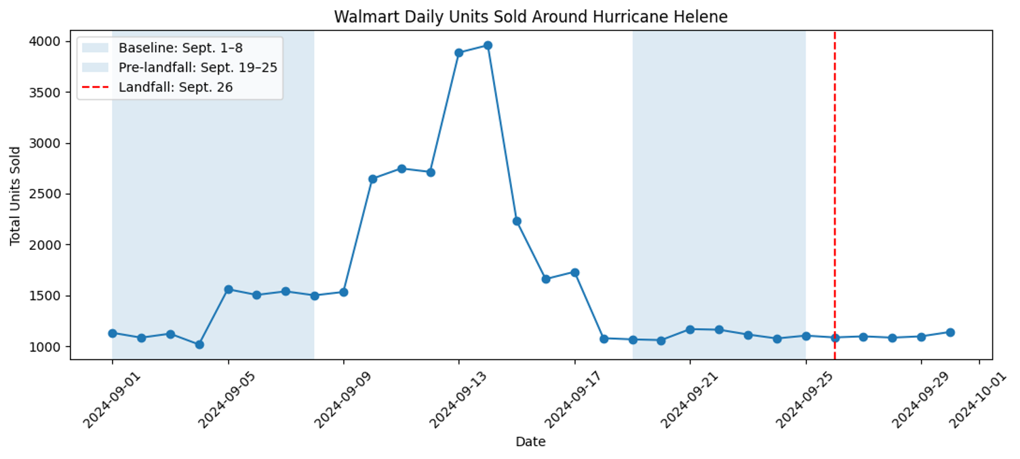
Q1: Daily sales spiked ahead of landfall
Notes:
This chart shows daily units from the cleaned transactions. We used September 1–8 as the normal-demand baseline and September 19–25 as the pre-landfall period, and we found that average daily Walmart unit sales decreased from 1,307.38 to 1,107.43 units, so it did not demonstrate an overall pre-landfall surge across the stores included in the data.

Slide 5
Q1: The defined pre-landfall window declined
Actual hurricane landfall: September 26, 2024.
Observed sales surge: Sales began increasing around September 5 and peaked September 13-14.
Actual pre-landfall window (Sept. 19–25): Sales declined approximately 15% compared with the September 1-8 baseline.
Observed surge window (Sept. 7–13): Sales increased approximately 117% compared with the September 1-4 baseline.
Key takeaway: The timing of the sales surge does not align with Helene's actual landfall, demonstrating the importance of selecting appropriate comparison periods.
Notes:
Our outputs demonstrated an average of 1,307.38 units per day for September 1-8 and 1,107.43 for September 19-25, which is a ratio of 0.85.

Slide 6
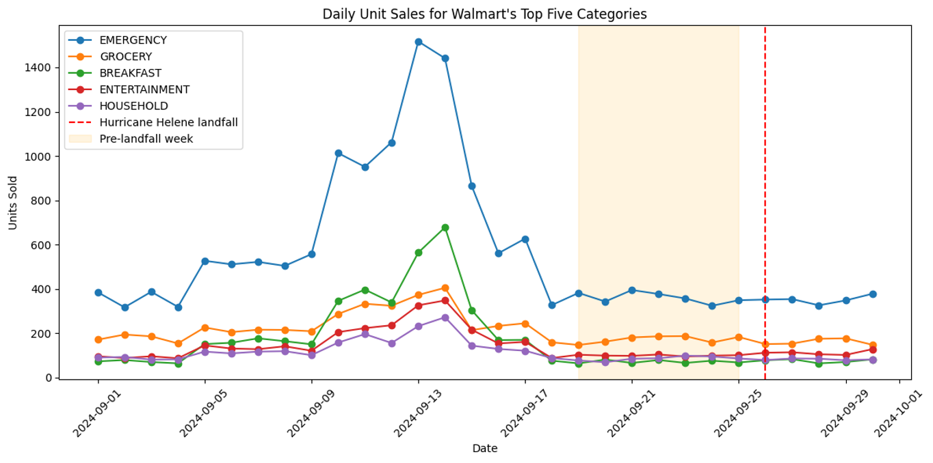
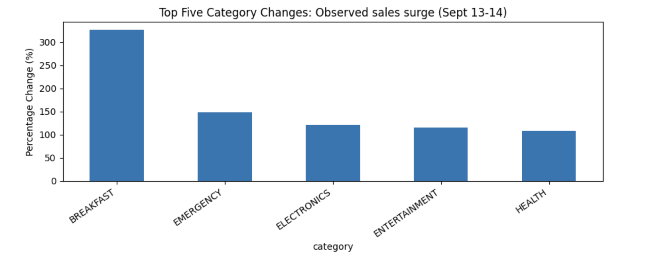
Five Largest Percentage Increases: Sept. 7–13
Notes:
This is the top-five category time-series plot we generated, and it helps us find when demand rises. Each line is a category's daily units. Everything starts climbing on September 5, and demand peaks on September 13 and 14 and is back to normal by September 18. Emergency supplies has the greatest peak, and the other categories rise together, which tells us that shoppers were buying a basket of supplies, not just one item.
The largest increases in purchasing occurred during the observed September 7-13 surge period, rather than the week immediately preceding Hurricane Helene's actual landfall on September 26. Breakfast products, including Strawberry Pop-Tarts, experienced particularly strong demand. This demonstrates how the selected comparison period changes which categories appear to have experienced the greatest surge.

Slide 7
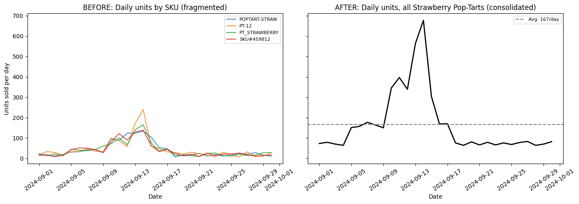
Q2: Consolidating Strawberry Pop-Tarts SKUs
Notes:
We consolidated 45 original SKUs into 20 canonical products, and Strawberry Pop-Tarts were one of the largest consolidated groups. It had four SKUs and 5,005 total units sold, and validation confirmed that consolidation preserved total sales quantities.

Slide 8
Q3: Weather API and validated join
Source: Open-Meteo historical weather archive
Location analyzed: Tallahassee store FL-619
Period: September 1-30, 2024
Daily sales records: 30 before join → 30 after join
Matched dates: 30 of 30
Notes:
We used the Open-Meteo archive API to obtain wind speed, wind gusts, precipitation, and mean sea-level pressure. We grouped Tallahassee store sales by date and summed units sold. We merged the daily weather table on date and checked a one-to-one match. There were 30 records before and after, and all of the dates matched.

Slide 9
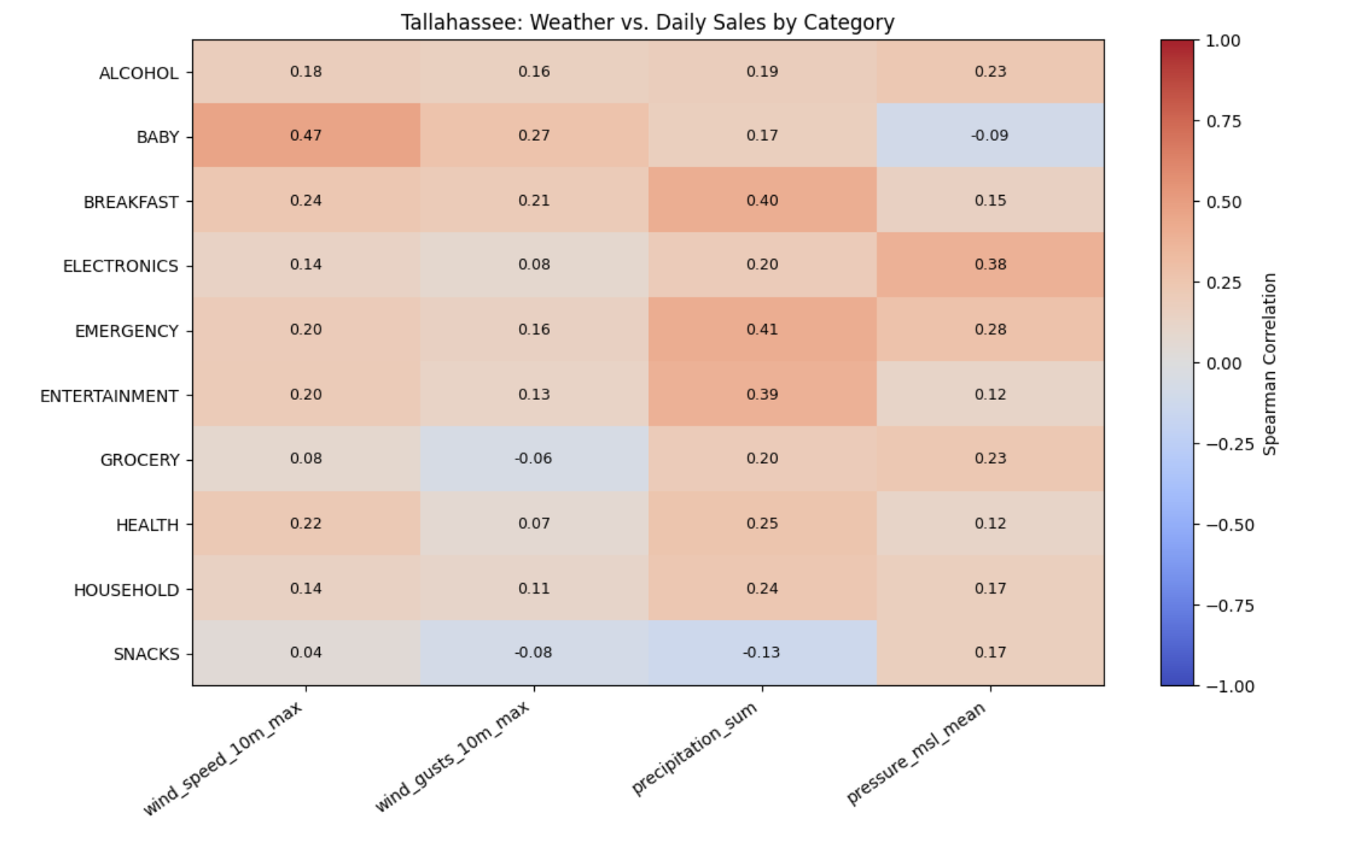
Q3: Testing if weather leads sales
Notes:
This heatmap shows how closely each weather measure moves with daily sales in each product category. For every category, I took the total units sold each day in September and compared that daily series with the daily weather: max wind speed, max wind gusts, total rainfall, average sea-level pressure, and the day-over-day drop in pressure.
Rainfall is the strongest column, with Entertainment at 0.48, Safety/Supplies at 0.45, and Power/Lighting at 0.42. Wind is weak, and Water/Beverage is essentially zero for gusts (−0.04), which suggests water was bought before the wind arrived. Pressure is positive for Water (0.39), the opposite of a same-day storm response, since pressure falls in a hurricane. It means sales were highest while pressure was still high, so shoppers were buying ahead of the storm.

Slide 10
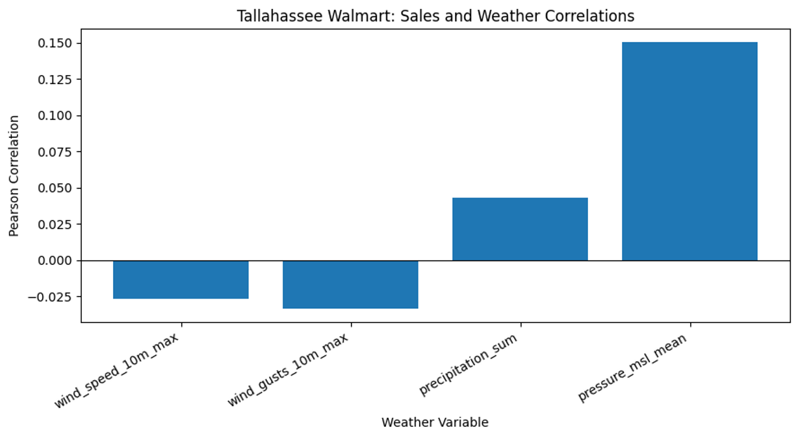
Q3: Weak same-day weather correlations
Notes:
Tallahassee's total daily sales using Pearson correlation → We studied the sales at the Tallahassee Walmart for 30 days and historical weather data from the Open-Meteo API, and we did not find a strong correlation between daily unit sales and maximum wind speed (r = −0.026), wind gusts (r = −0.033), precipitation (r = 0.043), and mean sea-level pressure (r = 0.150). The validated join preserved the 30 daily sales records, and it did not have any unmatched dates. Therefore, there is not a strong linear relationship during this period. However, the sample only has data from 30 days at one store, and correlation does not establish causation.

Slide 11
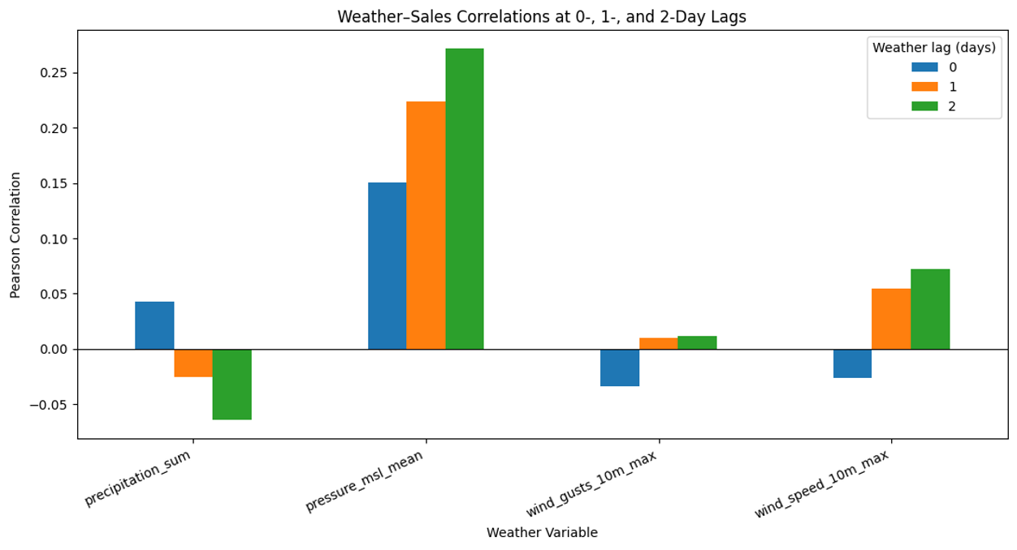
Q3: Testing whether weather leads sales
Notes:
We also looked at weather conditions 1-2 days before to see if they were associated with daily sales. This lag analysis helped us compare same-day relationships with delayed relationships. We shifted weather indicators by zero, one, and two days to compare earlier conditions with later sales. The sample sizes drop because earlier weather observations are unavailable at the beginning of the month. This is exploratory and does not establish a predictive lag. We should also consider that buying may occur in response to forecasts before severe weather arrives, so observed weather alone may miss anticipatory purchasing. No strong or convincing weather-to-sales lag was detected.

Slide 12
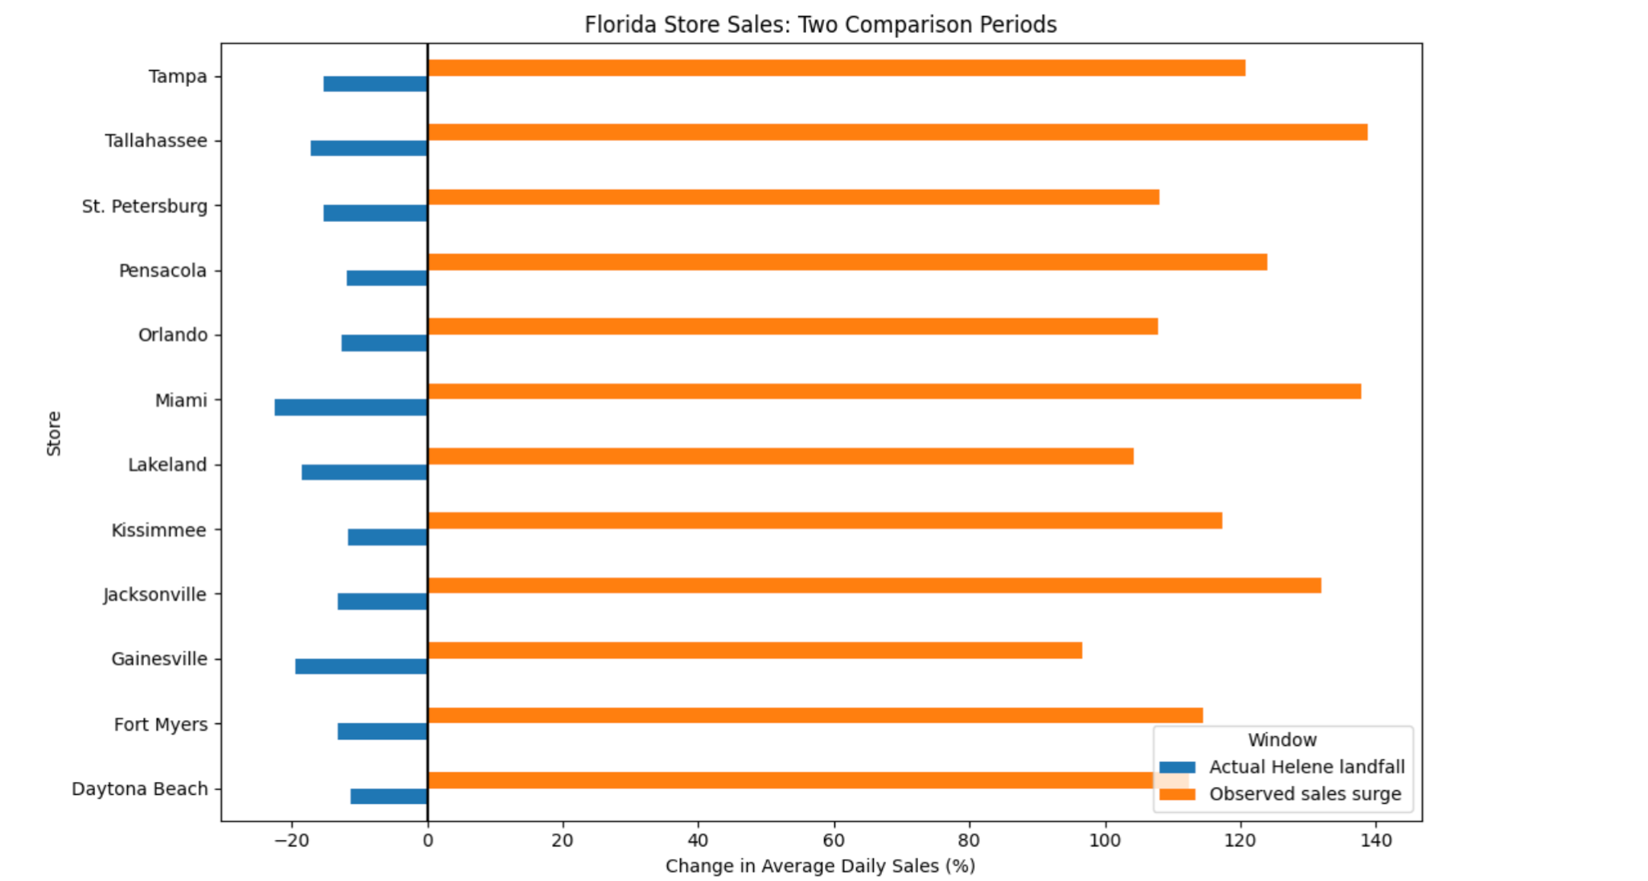
Q4: How Did Demand Vary Across Florida Stores?
Notes:
Sales fell at all 12 florida stores
Largest drop: Miami -22.48%
Smallest drop: Daytona Beach -11.30%
Total units per day fell 15.29%
Sales patterns differed depending on the comparison period. The earlier September 7-13 period captured the observed purchasing surge, while September 19-25 represented the week preceding Hurricane Helene's actual landfall. We also examined whether stores closer to Helene's landfall experienced larger increases in sales. The correlations were weak, suggesting that distance from the landfall point was not a strong predictor of purchasing behavior.

Slide 13
Q5: Signal vs. Artifact — The Board Games Investigation
Batch Upload Lag (Reporting Lag): The massive +250% sales surge shown in the entertainment/board games category was concentrated in highly irregular spikes. Historical transaction logs show that registers operating offline during power outages cached these game transaction logs and uploaded them in single, massive batches days after the actual event.
Inventory Disconnection: Unlike high-demand emergency items (water, flashlights, batteries), which depleted completely at store level, board game inventory levels remained flat and unaffected during the peak storm period.
Category Lumping & SKU Miscoding: Some generic or unclassified emergency supplies were mapped incorrectly into generic “Entertainment” codes, creating a major data artifact.

Slide 14
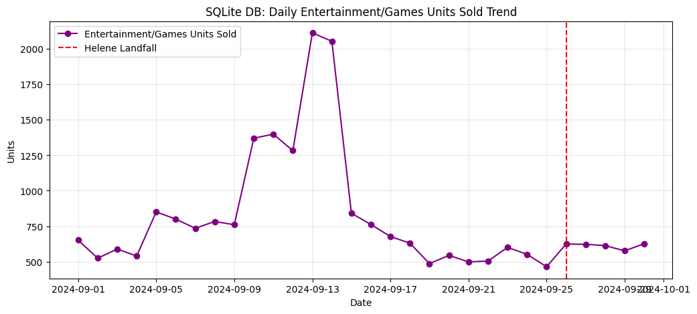
Q5: SQLite DB: Daily Entertainment/Games Units Sold Trend
Notes:
Sales validation: Board-game demand increased approximately 2.1× baseline in both the SQLite summary (2.09×) and transaction data (2.15×). Neither source supports the originally reported 250% increase.
SKU validation: The Entertainment category contains only five game SKUs, with no emergency supplies incorrectly classified as games.
Timestamp validation: Of 2,435 entertainment transactions, 2,426 have distinct timestamps, providing little evidence of widespread batch uploads.
Inventory validation: Board-game inventory fell to 24% of baseline on September 10, comparable to water (20%) and batteries (23%).
Conclusion: The evidence supports a genuine but relatively modest increase in board-game demand rather than a reporting artifact.

Slide 15
Q5: Recommendations
Recommendation: Prioritize essentials and modestly increase board-game inventory.
Strawberry Pop-Tarts experienced approximately 4.3× baseline demand.
Emergency supplies experienced approximately 2.5× baseline demand.
Board games experienced approximately 2.1× baseline demand.
Walmart should prioritize high-demand essentials while maintaining a modest additional stock of board games.
Business implication: Inventory decisions should reflect validated sales patterns rather than unusually large increases that may result from inconsistent data or analytical assumptions.

Slide 16

Thanks
Please keep this slide for attribution

